Slide 1
Exercise 2

Slide 2
What a Perceptron can do?
And Operation
$\left(0.0, 0.0\right) \left(0.0, 1.0\right) (1.0, 0.0)$ $(1.0, 1.0)$
x₁
w₁
y
∑
f
y
x₂
w₂
w₃
1
w₁ = 1.0 , w₂=1.0 , w₃=-1.5
x

Slide 3

Coding 전에 생각해 볼 것
입력 데이터 : (0.0)(0.0), (0.0)(1.0), (1.0)(0.0), (1.0)(1.0)
출력 데이터 : (0.0), (0.0), (0.0), (1.0)
Optimizer: gradient descent method
Loss function: Mean square error
y
model
x
$${w3,w}_{2}, w_{1}$$

Slide 4
준비 단계 1
입력 데이터 : (0.0)(0.0), (0.0)(1.0), (1.0)(0.0), (1.0)(1.0)
출력 데이터 : (0.0), (0.0), (0.0), (1.0)
Model: nn.linear
Loss function :F.mse_loss()
Optimizer:SGD
Learning rate:0.001

Slide 5
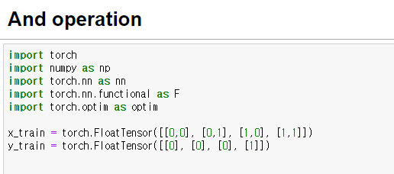
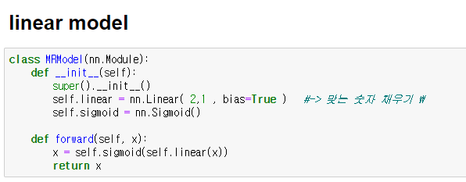
Exercise 1

Slide 6
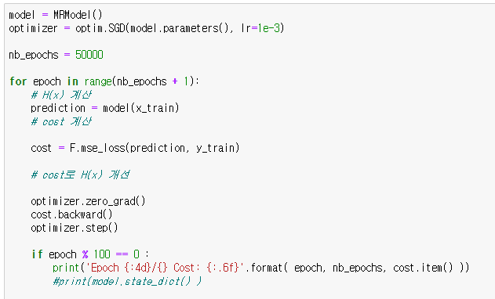
Exercise 1

Slide 7
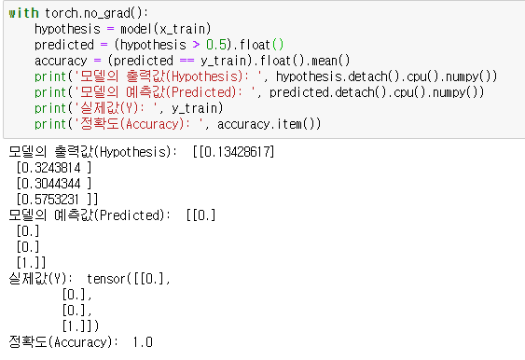
Exercise 1

Slide 8
What a Perceptron can do?
Xor Operation
$\left(0.0, 0.0\right) \left(0.0, 1.0\right) (1.0, 0.0)$ $(1.0, 1.0)$
x₁
w₁
y
∑
f
y
x₂
w₂
w₃
1
w₁ = ?, w₂= ?, w₃= ?
x

Slide 9
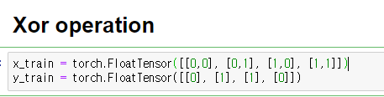
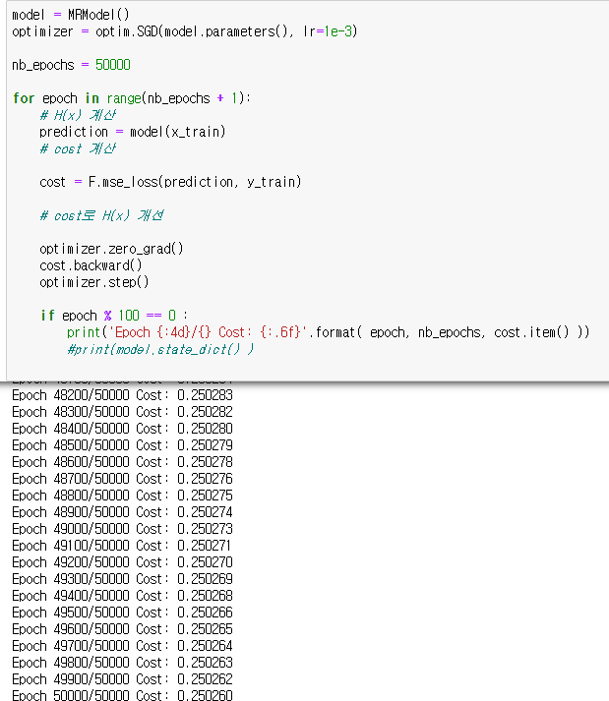
Exercise 2

Slide 10
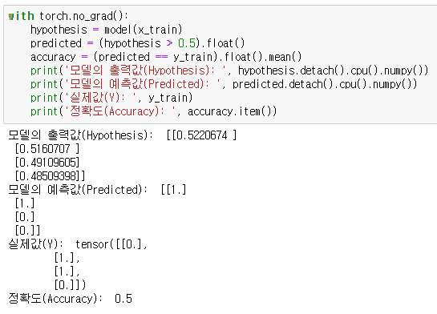
Exercise 2

Slide 11
How to fix it?
Xor Operation
$\left(0.0, 0.0\right) \left(0.0, 1.0\right) (1.0, 0.0)$ $(1.0, 1.0)$
x₁
w₁
x₂
∑
f
∑
f
∑
f
w₂
w₃
1
.
.
.
.
.
.
∑
f
y
∑
f
∑
f

Slide 12
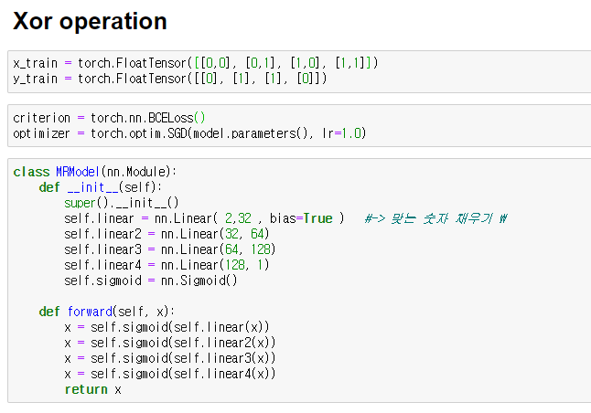
Exercise 2

Slide 13
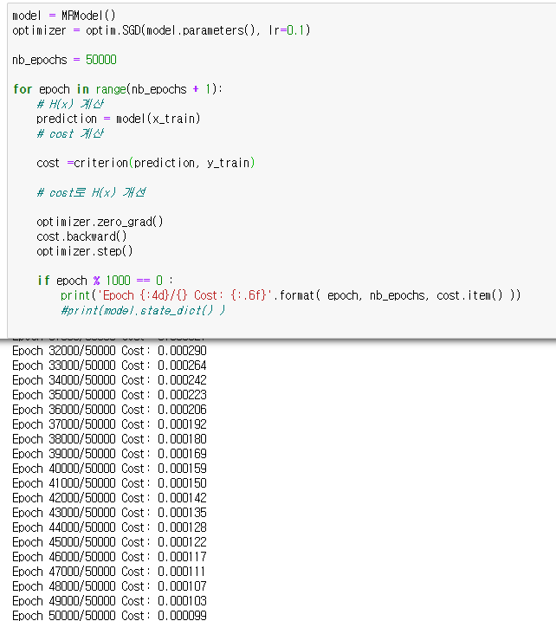
Exercise 2

Slide 14
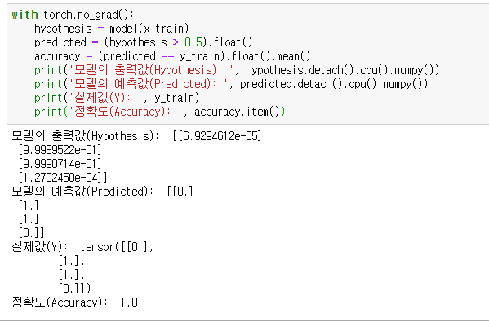
Exercise 2

Slide 15
Question and Answer

